Slide 1
Knowledge Embedding Project
Jie Zhou, Zhengyan Zhang
2019.07.21

Slide 2
Project Tasks
Tasks
TransE Implementation (5 points)
Embedding Analysis (5 points)
TransR + Analysis (bonus, 5 points)

Slide 3
Problem 1
TransE
Complete TransE algorithm based on TensorFlow.
We have prepared the framework and there are only a couple of lines to finish.
Make sure your code can be compiled and the loss is decreasing.

Slide 4
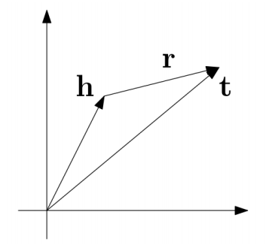
TransE
For each triple (head, relation, tail), relation as a translation from head to tail
Learning objective: h + r = t
Bordes, et al. (2013). Translating Embeddings for Modeling Multi-relational Data. NIPS.

Slide 5
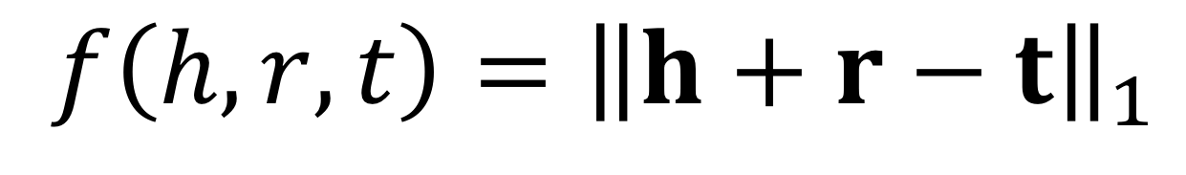
Objective Function
Energy Function
For correct (h, r, t)，requires h + r = t
$$f\left(h,r,t\right)={\left\|h+r−t\right\|}_{1}$$

Slide 6

Objective Function
Energy
Function
$$f\left(h,r,t\right)={\left\|h+r−t\right\|}_{1}$$
Objective
Function
where
triple sets in KG
negative triple sets not in KG

Slide 7
Problem 2
Write your own code to analyze the embeddings learned by TransE
We will provide the entity and relation embeddings and other necessary information.
Given head entity Q30, relation P36, what is the closest tail entities?
Given head entity Q30 and tail entity Q49, what is the most likely relations?
You can go https://www.wikidata.org/wiki/Q30 and https://www.wikidata.org/wiki/Property:P36 to check the actual meanings of the entity and relation and further make sure your program gives reasonable results.

Slide 8
Problem 3 (bonus)
Implement TransR algorithm based on Problem 1
Evaluate TransR as you did in Problem 2

Slide 9
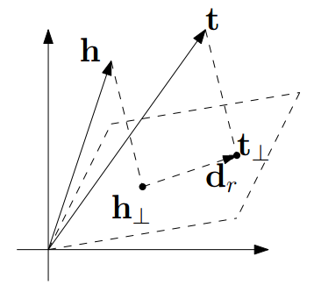
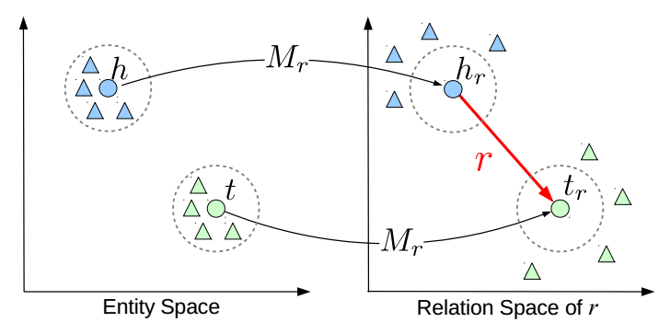
Complex Relations
Build relation-specific entity embeddings
TransH
TransR
Wang, et al. (2014). Knowledge graph embedding by translating on hyperplanes. AAAI.
Lin, et al. (2015). Learning entity and relation embeddings for knowledge graph completion. AAAI.

Slide 10
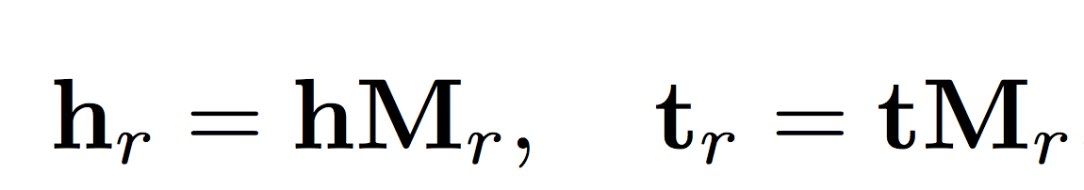
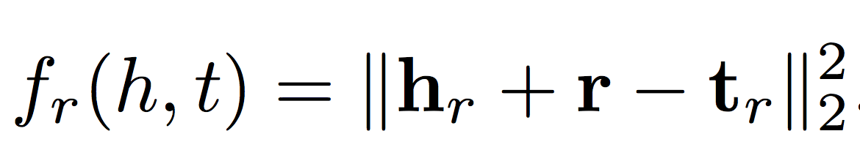
TransR

Slide 11
Submissions
Task 1
Codes + Embedding files.
Task 2
Codes.
A brief report (in txt format) includes the embeddings you use in the experiment and your answers for the questions.
Task 3
Codes + Embedding files.
A brief report.

Slide 12
Useful APIs
TensorFlow
reduce_sum()
maximum()
matmul()
norm(), abs(), square(), sqrt()
Numpy
loadtxt(filename)
argsort(), sum(), square(), absolute()

Slide 13
Q&A

